Slide 1
Practical SQL Server​
Tips, Tricks and Random Thoughts​
Notes:
Thank everyone for attending.
No, this is not a mobile presentation… but… backing enterprise mobile applications / websites is typically enterprise amounts of data, so I am hoping this will be a relevant topic for everyone
Objectives for me are to:
Share some experience / knowledge… I really hope that each of you will take something away from this presentation other than just a free meal
and
Hear from others what their experience is… feel free to stop me at any point to provide some of your own thoughts / ideas along the way
and
Use this as an opportunity to refresh or learn some new things myself as I prepared this presentation

Slide 2
Agenda
SQL Server still relevant?
How to get started (product / training)
SSMS Tips
Deprecated Features
Formatting SQL
Performance
…

Slide 3
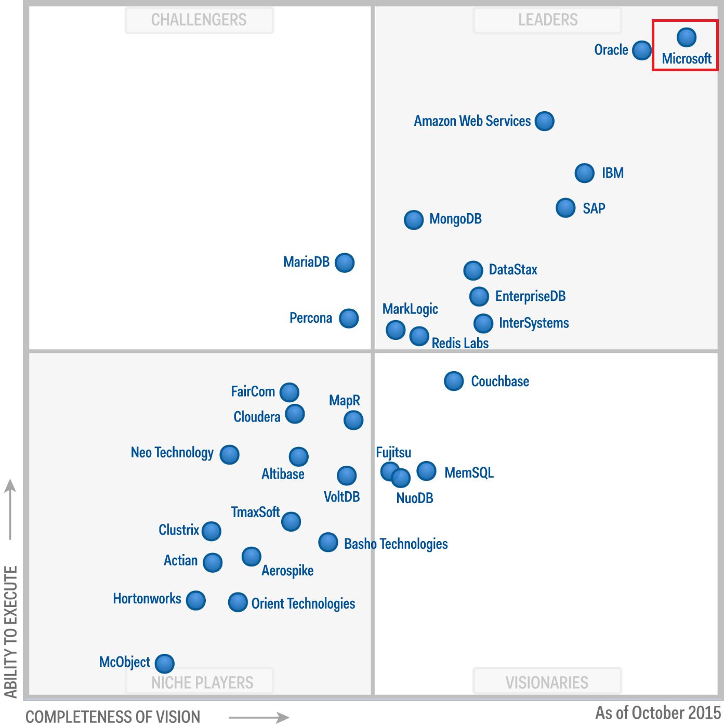
Gartner - Magic Quadrant for Operational Database Management Systems
Notes:
SQL Server is a major product for Microsoft and they keep investing in it and it keeps getting recognized as a market leader.
Here is a visual of Gartner’s Magic Quadrant for Operational Database Management Systems as can be found here: https://www.gartner.com/doc/reprints?id=1-2PMFPEN&ct=151013&st=sb
Another interesting one not shown here is Gartner’s Magic Quadrant for Business Intelligence and Analytics Platforms https://www.gartner.com/doc/reprints?id=1-2XYY9ZR&ct=160204&st=sb

Slide 4

Microsoft is bringing SQL Server to Linux in 2017
Notes:
On March 7, 2016 Microsoft announced that they have plans to bring SQL Server to Linux next year…
http://blogs.microsoft.com/blog/2016/03/07/announcing-sql-server-on-linux/#sm.0000au606lw5keoovky1fqia4axay
This is big news and could alter landscape for those shops that might have been hesitant to use Windows Servers in a Linux shop
…or not? We will see

Slide 5
Getting started – for free?
SQL Server 2014 Express
Or
Join “Visual Studio Dev Essentials” free program and get SQL Server Dev Edition for Free
Notes:
SQL Server 2014 Express: https://msdn.microsoft.com/en-us/sqlserver2014express.aspx
Also see: http://sqlserverupdates.com/download-sql-server/
NOTE: once installed and trying to keep track of updates/versions go here: http://sqlserverbuilds.blogspot.ca/

Slide 6
Training – for free?
Microsoft Virtual Academy
Lynda.com via Regina Public Library (24 courses)
Red-Gate books
Websites / Newsletters:
SQL Server Central
Blogs from SQL Skills
Brent Ozar (sp_AskBrent and sp_Blitz)
Simple-talk
SQL Blog (sp_whoisactive)
SQL Sentry TV
…no shortage of options…
Notes:
Obviously these days there is a LOT of free information out there. Listed on this slide though are my recommendations

Slide 7
SSMS Tips
Color coding connections
Registered Servers…
friendly names
Running same query across servers
Remember… SSMS is built upon Visual Studio shell so similar functionality available
Ctrl+Shift+U / Ctrl+U
Shift+Alt+arrow keys
Ctrl+K+C / Ctrl+K+U
Notes:
Starting with some “quick wins”… many of you might be aware of these, but hopefully some of these tips/tricks will be new to you

Slide 8
SSMS Tips Cont’d
Drag and drop for all column names
Filtering objects
Line numbers** MUST!
Refresh local cache
Templates
Snippets
Inserting lots of data
**DEMO**
Notes:
Start SSMS and *quickly* demo a bunch of features
For SQL to run across all registered servers use… will also show way to insert lots of data too and the “sp_Blitz” proc mentioned 2 slides ago:
C:\LocalDev\2016-06\GitMe\2016-June-AppPractice\Supporting Scripts\00 - Query to run across all registered servers.sql

Slide 9
SQL Tips – Deprecated Features
Be aware of future requirements / deprecated features
Key ones I am seeing…
Get used to using ;
TOP instead of SET ROWCOUNT
sp_attach_db
DBCC DBREINDEX
SET FMTONLY
Etc…
Not necessarily deprecated but a bit obsolete?
INFORMATION_SCHEMA
Notes:
; one is something I am still not used to personally… even though I program in JavaScript and C#
https://www.brentozar.com/archive/2015/12/give-your-t-sql-a-semicolonoscopy/
For not using INFORMATION_SCHEMA, consider:
http://sqlblog.com/blogs/aaron_bertrand/archive/2011/11/03/the-case-against-information-schema-views.aspx
See script:
C:\LocalDev\2016-06\GitMe\2016-June-AppPractice\Supporting Scripts\05 - querying for tables and columns.sql

Slide 10
SQL Tips – Deprecated Feature – SQL Profiler
Get used to Extended Events
SSMS GUI
**DEMO**
Notes:
Show query that maps profiler / trace events to XE
C:\LocalDev\2016-06\GitMe\2016-June-AppPractice\Supporting Scripts\10 - Mapping profiler to extended events.sql

Slide 11
SQL Tips – Formatting
Why does this matter? Readability/Maintainability/Catches Errors
Good list here
Commas… consensus seems to be at end… but…
*if* use aliases be clear and use “AS”
Comments…
your code is NOT self-documenting!
Do NOT use as change log
UPPERCASE reserve words
Line breaks and tabs… use whitespace liberally
Formatters:
SQL Prettifier / T-SQL Tidy / PoorSQL / SQL Formatter Online
**DEMO**
Notes:
Warning… this may be controversial… but worse is to have NO direction
Simplistic formatting example here:
C:\LocalDev\2016-06\GitMe\2016-June-AppPractice\Supporting Scripts\20 - Formatting SQL.sql

Slide 12
Performance – Basics
If doing timings then:
Clear buffer pool/caches on dev box while tuning
But more importantly:
Turn “STATS” on
Display Actual Execution Plan (compare estimate to actuals)
Parsing STATISTICS
Online Statistics Parser
Excel Template for Parsing Statistics IO
…or use SQL Sentry Plan Explorer
**DEMO** …showing sql only, not running
Notes:
See script:
C:\LocalDev\2016-06\GitMe\2016-June-AppPractice\Supporting Scripts\40 - Perf basics.sql
Important DMVs
- system info: sys.dm_os_performance_counters, sys.dm_os_wait_stats
- query info: sys.dm_exec_requests
- index info: sys.dm_db_index_usage_stats, sys.dm_io_virtual_file_stats

Slide 13
Performance – SARGABLE
Search ARGument ABLE
If can take advantage of an index
Avoid functions in criteria/joins
…actually, might want to avoid functions just in general** more later
**DEMO**
Notes:
See script:
C:\LocalDev\2016-06\GitMe\2016-June-AppPractice\Supporting Scripts\41 - some date stuff.sql

Slide 14
Performance – Return only data you need
Index Seek… great… but what about “Key Lookup” cost?
While we are at it… never ever put SELECT * in a view!
Real world SLGA experience ☺
**DEMO**
Notes:
See script:
C:\LocalDev\2016-06\GitMe\2016-June-AppPractice\Supporting Scripts\42 - Avoid Select Star.sql

Slide 15
Performance – EXISTS
EXISTS vs IN should always end up with same plan
NOT EXISTS vs NOT IN is a different story… use NOT EXISTS
NOTE: if there are NULLs then DEFINITELY use NOT EXISTS
That being said… at a conceptual level
If subquery contains large volume of data then use EXISTS
If subquery contains small volume of data then use IN
**DEMO**
Notes:
See script:
C:\LocalDev\2016-06\GitMe\2016-June-AppPractice\Supporting Scripts\51 - EXISTS - SELECT piece does not matter.sql
Or online at
http://data.stackexchange.com/stackoverflow/query/476826?opt.textResults=true&opt.withExecutionPlan=true#executionPlan
http://bit.ly/AB-NOTIN

Slide 16
Performance – Parameter Sniffing
One of the biggest issues I continue to see
First execution of proc caches a plan that is suboptimal for subsequent calls
Consider statement level recompilation
OPTION (RECOMPILE);
**DEMO**
Notes:
See script:
C:\LocalDev\2016-06\GitMe\2016-June-AppPractice\Supporting Scripts\51 - Parameter sniffing.sql

Slide 17
Performance – Avoid SQL Functions
Execution plan lies
No parallelism possible
**DEMO**
Notes:
http://www.sqlsentry.com/products/plan-explorer/sql-server-query-view
See script:
C:\LocalDev\2016-06\GitMe\2016-June-AppPractice\Supporting Scripts\52 - SQL Functions are bad.sql

Slide 18
Other Tips
Check errors in procs… errors will not necessarily stop execution
@@ERROR
BEGIN TRY / END TRY + BEGIN CATCH THROW END CATCH
Use RAISERROR for timings
Searching PROCs script… note that some procs span multiple sys.syscomments rows
**DEMO**
Notes:
See script:
C:\LocalDev\2016-06\GitMe\2016-June-AppPractice\Supporting Scripts\60 - Check your errors in proc.sql
See script:
C:\LocalDev\2016-06\GitMe\2016-June-AppPractice\Supporting Scripts\70 - RAISERROR instead of PRINT statements.sql
See script:
C:\LocalDev\2016-06\GitMe\2016-June-AppPractice\Supporting Scripts\90 - Searching PROCs.sql

Slide 19
New(ish) Features to consider
Insert multiple sets using commas
Magical computed columns
Pagination
OFFSET @RowsToSkip ROWS
FETCH NEXT @RowsPerPage ROWS ONLY
sp_describe_first_result_set
Use OUTPUT to show rows affected
**DEMO**
Notes:
See script:
C:\LocalDev\2016-06\GitMe\2016-June-AppPractice\Supporting Scripts\91 - Insert using commas for sets.sql
C:\LocalDev\2016-06\GitMe\2016-June-AppPractice\Supporting Scripts\91 - Magic computed column.sql
C:\LocalDev\2016-06\GitMe\2016-June-AppPractice\Supporting Scripts\91 - Pagination and describe first resultset.sql
C:\LocalDev\2016-06\GitMe\2016-June-AppPractice\Supporting Scripts\91 - Showing OUTPUT usage.sql

Slide 20
Other free tools…
Downloadable Tools:
Data Generator, Idera Tools, SQL Query Stress
SQL Sentry Plan Explorer** more about later
Great set of SQL admin scripts
Compose Queries From StackOverflow Q & A data
Ex. Queries per month for tags
Notes:
There are also a lot of free tools out there that I list here.
…And 2 other links, one to a great resource of SQL admin scripts on GitHub and the other that I will show now that not sure if people are aware of…
… did you know you can query all of StackOverflow’s data? You can also DOWNLOAD it all too which will allow you to have a great set of enterprise size data to run queries off of to learn a bit about SQL Server performance and of course to analyze StackOverflow trends, etc yourself

Slide 21
SQL Tips – Instance and Database Settings
Review this PDF
Instance
optimize for ad hoc workloads … set to 1
Set server memory to something other than 2 petabytes (its default)
Database
Compress backups
Notes:
C:\LocalDev\2016-06\GitMe\2016-June-AppPractice\Supporting Scripts\95 - Setting optimize for ad hoc workloads to True.sql
C:\LocalDev\2016-06\GitMe\2016-June-AppPractice\Supporting Scripts\95 - Set backup compression as default.sql

